Slide 1
APTA-Nebraska – Repeal of MPPR
UHCCP
Notes:
7:13 pm APTA at work for the profession: Alice, Elise
Telehealth update
APTA working on developing consistent approach to virtual/remote vendors
AMA CPT: updates to share?
:03 – :05mins Telehealth update – Alice will provide commercial payer update
:05 mins – Elise/Alice will provide an overview of work in progress to address remote/ virtual vendors
:05mins CPT code applications – Alice will provide an overview and present updates regarding the October CPT committee meeting and activities related to the NCCI PTP Edits

Slide 2

APTA-NE Component Payer Chair Presentation
Objectives
Understand process for removing MPPR for United HealthCare Community Plan (UHCCP)
Elaborate on the importance of collaboration with other disciplines in our state
Highlight the importance of perseverance
Engage membership and meet with your lobbyist and State legislators.

Slide 3



APTA-NE UHCCP MPPR
Heritage Health – (3) MCO’s in 2017
UHCCP – annual meetings
Nebraska Total Care – Advisory Board
Healthy Blue – Bimonthly Meetings

Slide 4


APTA-NE UHCCP MPPR
UHCCP – initially was the ‘best’ of the 3 MCO’s. No auth’s
Changes to their policies happened quickly
Met as a coalition, Speech-Language & Hearing, Occupational, & Physical Therapists(SLOPT) with UHCCP each year
Met with pre-authorization author, Shannon, locally and on a national level at CSM

Slide 5
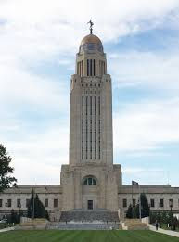
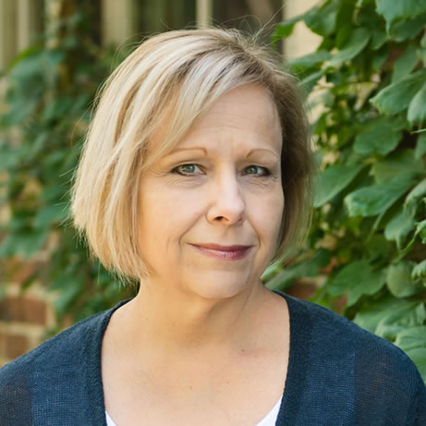
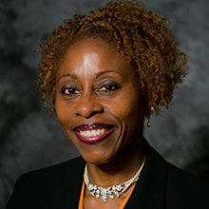
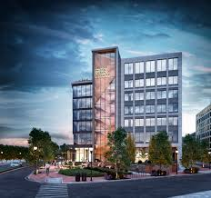
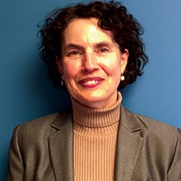
APTA-NE UHCCP MPPR
What else did we do?
Engagement of membership of SLOPT
Surveys, newsletters, blogs
Met with State Senators – multiple occasions, meetings set up by lobbyist, Julie Erickson
Annual legislative breakfasts at State Capitol, 2021 was virtual and the best one yet. 5 of the 49 senators on the Zoom meeting. 100% were PT patients
Senators very interested in specific examples of the effect of MPPR on reimbursement—EOB’s. Wanted to ensure no increase
Guidance from Elise Latawiec and Wanda Evans (APTA)

Slide 6
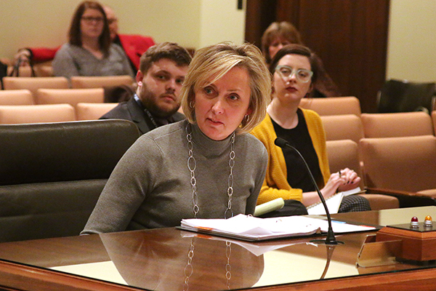
APTA-NE UHCCP MPPR
2020 - Strong relationship built with Senator Lynn Walz – who authored our ‘orange envelope’ law- requires MCO’s to alert providers >90 days in advance of significant changes to their authorization and/or billing processes
LB 956

Slide 7
Final Meeting UHCCP
Virtual local meeting with UHCCP in NE – 12/20
UHCCP and SLOPT met and verbal agreement reached to remove MPPR-new CEO
Email confirming this decision 1 week later
Lobbyist advice
Moved forward after another meeting w/Senator Walz to put forth LB 100
LB 100 – permanently remove MPPR from MCO’s in NE
Committee Hearing
Passed 1st round in Legislature, 36-0, 12-No votes

Slide 9
Questions & Answers

